Slide 1
Analysis of the Worldwide Transit Systems
By: Angelina, Brian, MaiDao and Matt
University of Minnesota Visualization and Data

Slide 2
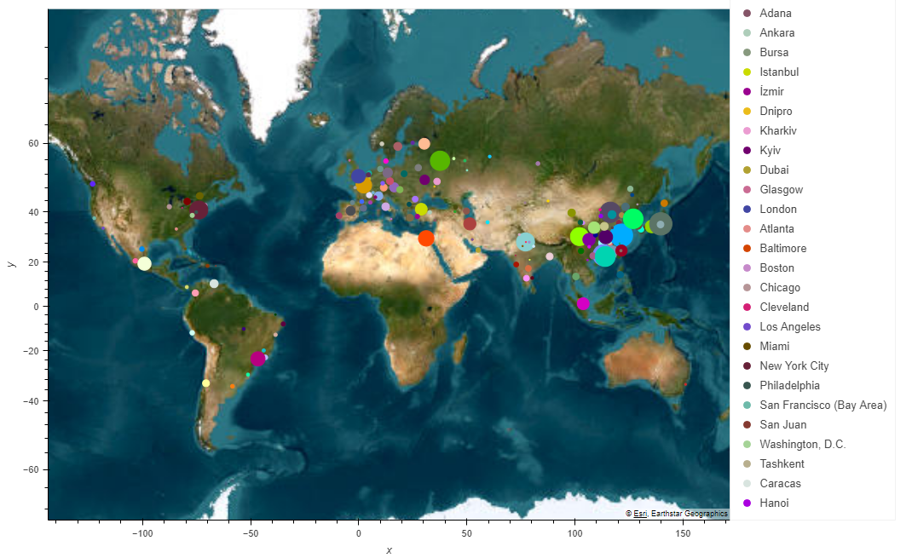
Metro-Systems-Worldwide | Kaggle

Slide 3
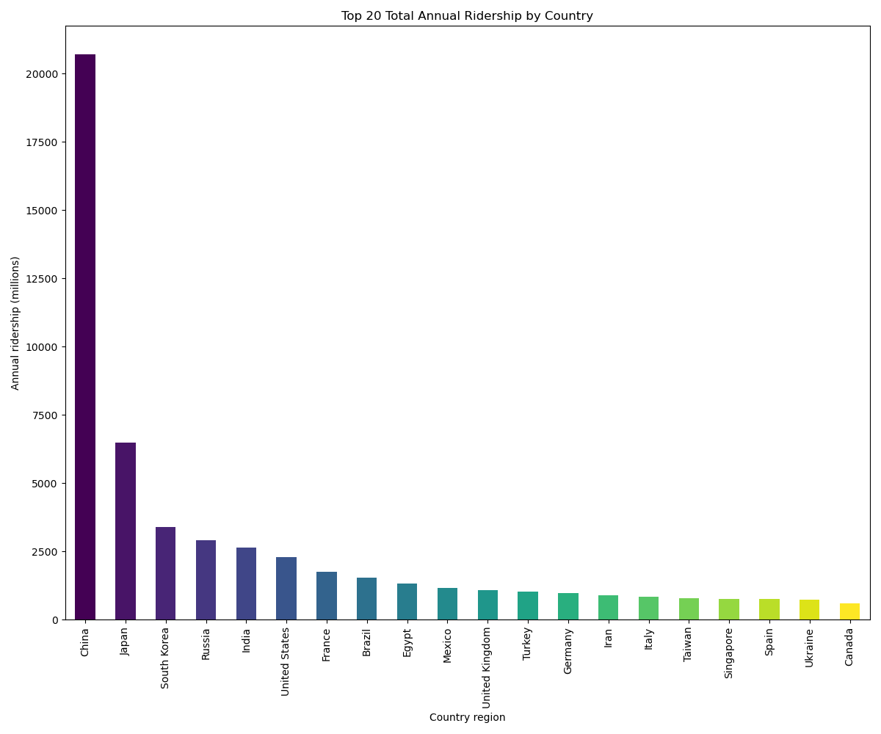

Slide 4
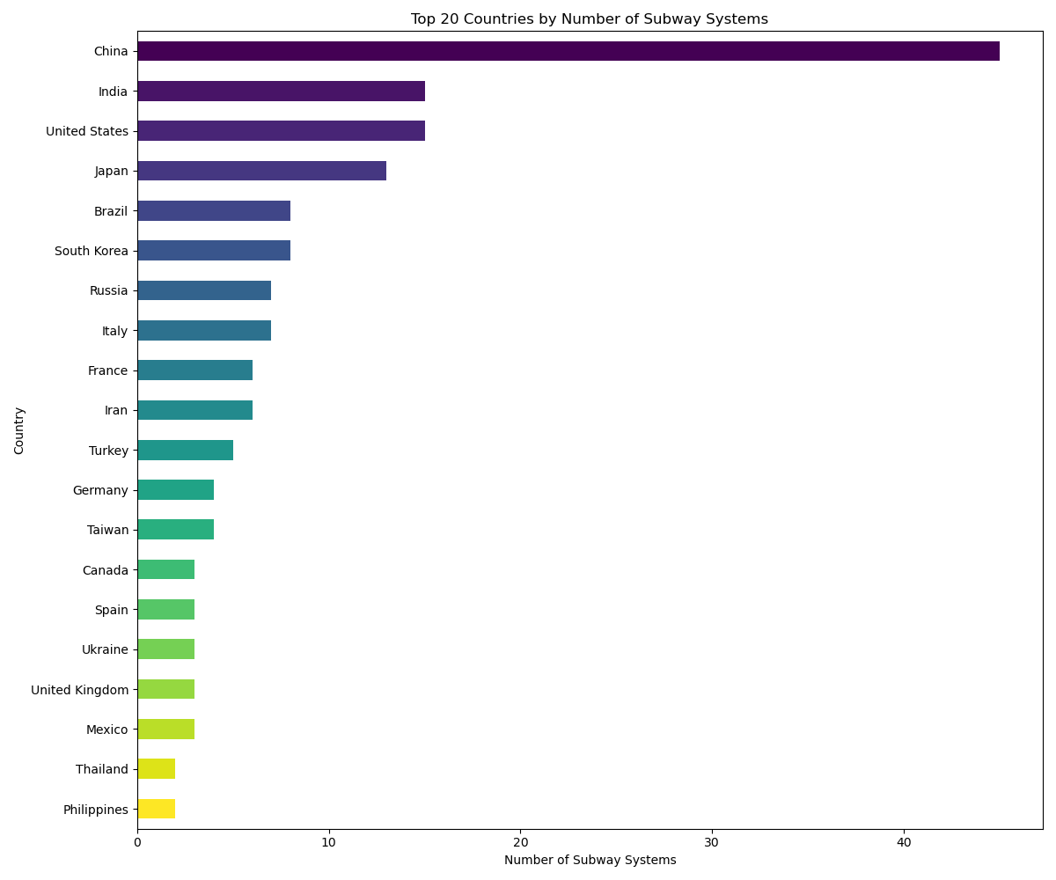
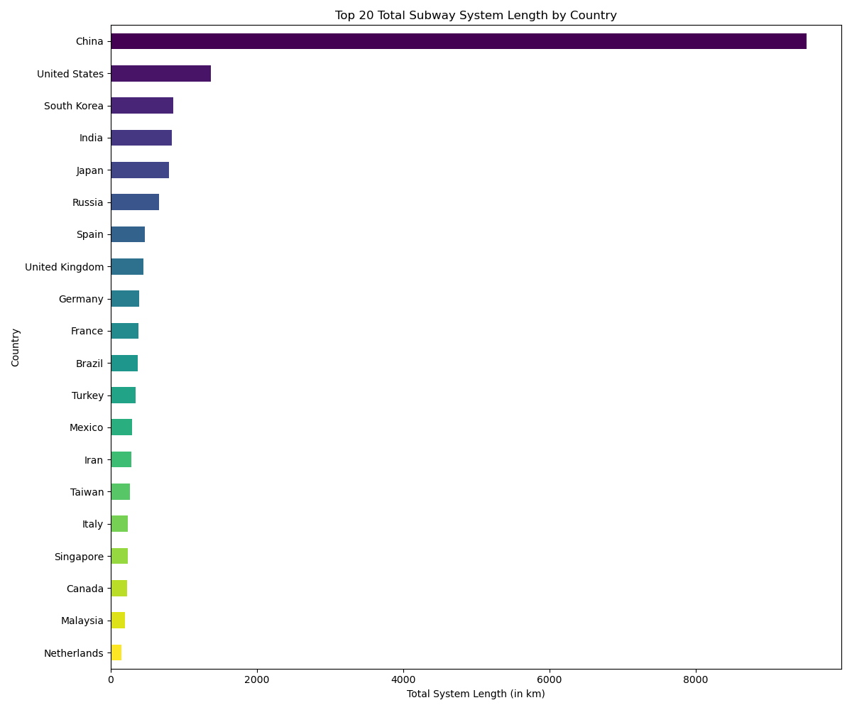

Slide 5
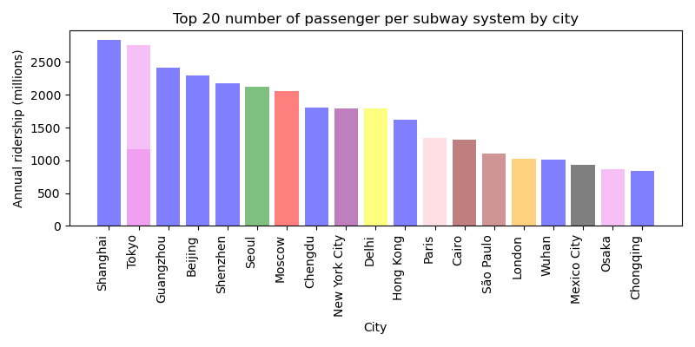

Slide 6
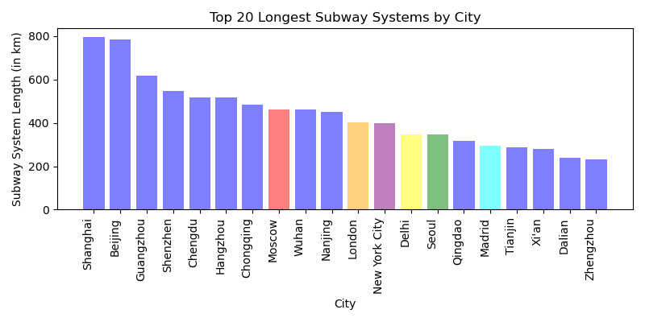

Slide 7
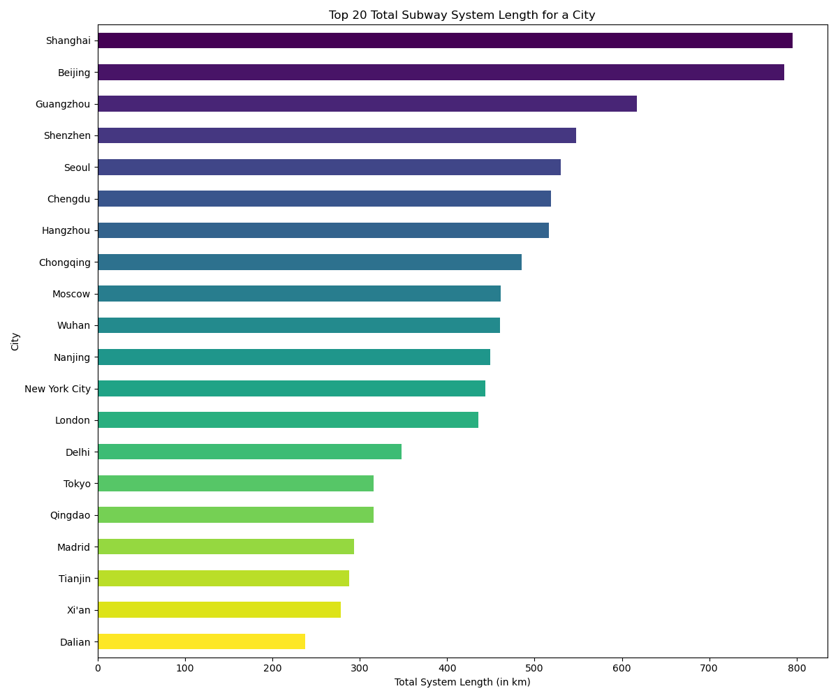

Slide 8
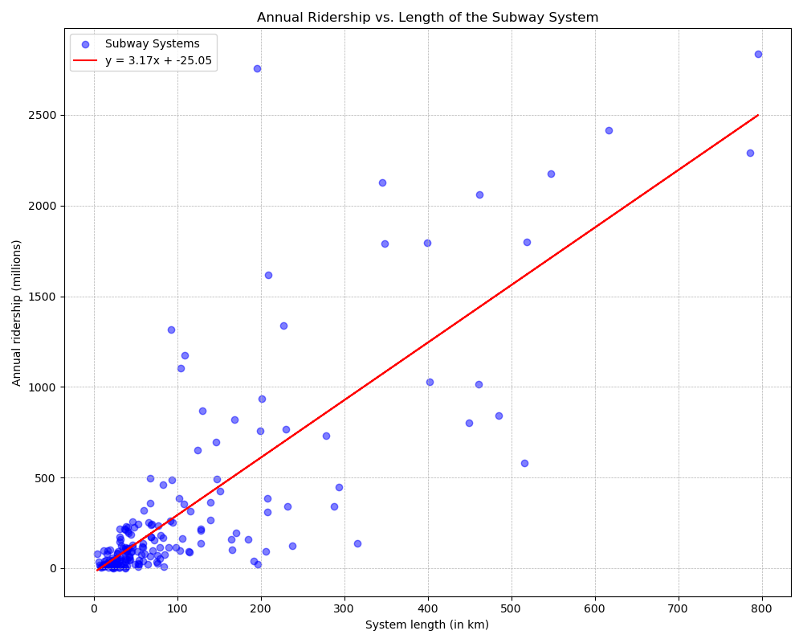
The R²-value is: 0.65

Slide 9
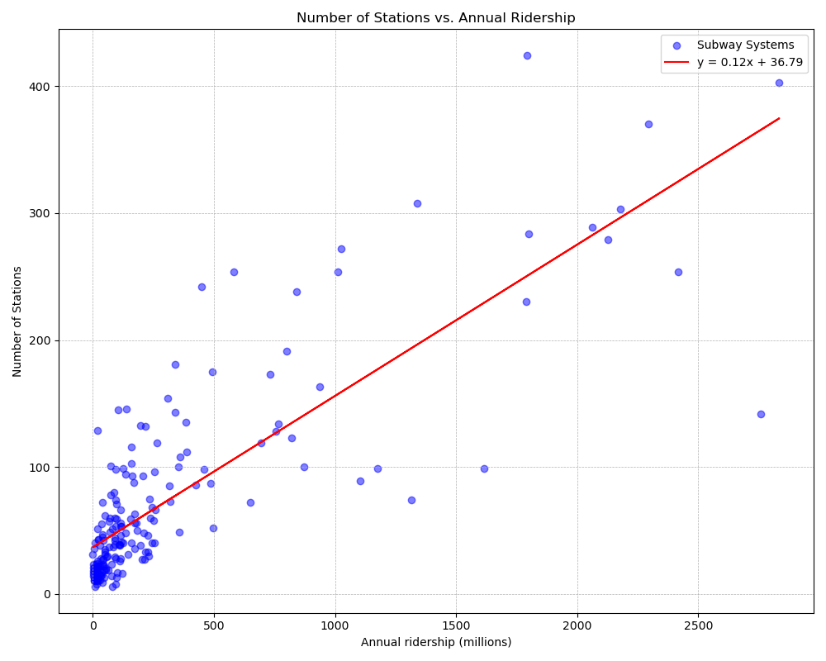
The R²-value is: 0.67

Slide 10
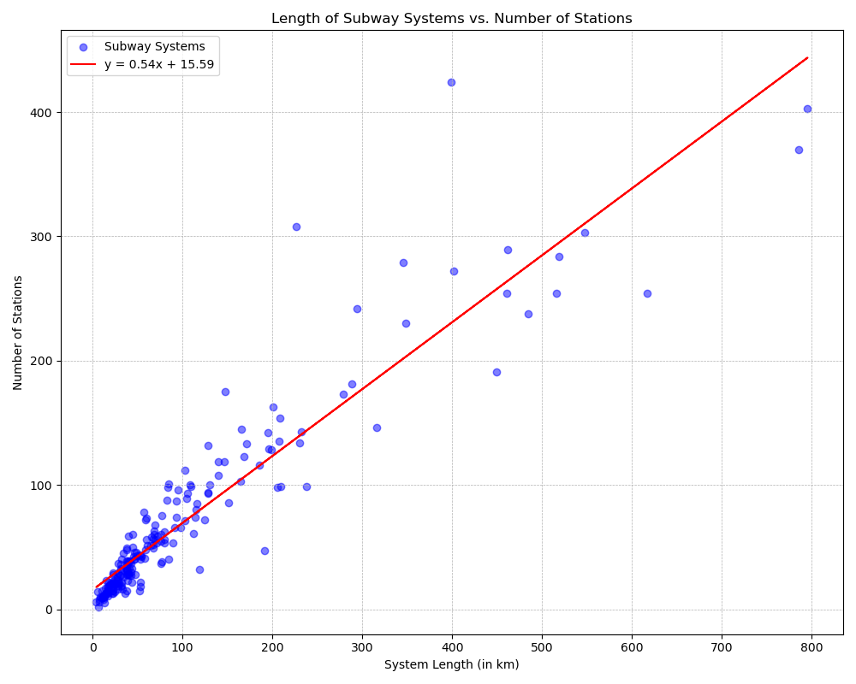
The R²-value is: 0.87

Slide 11
Conclusions and Future Analysis

